Slide 1
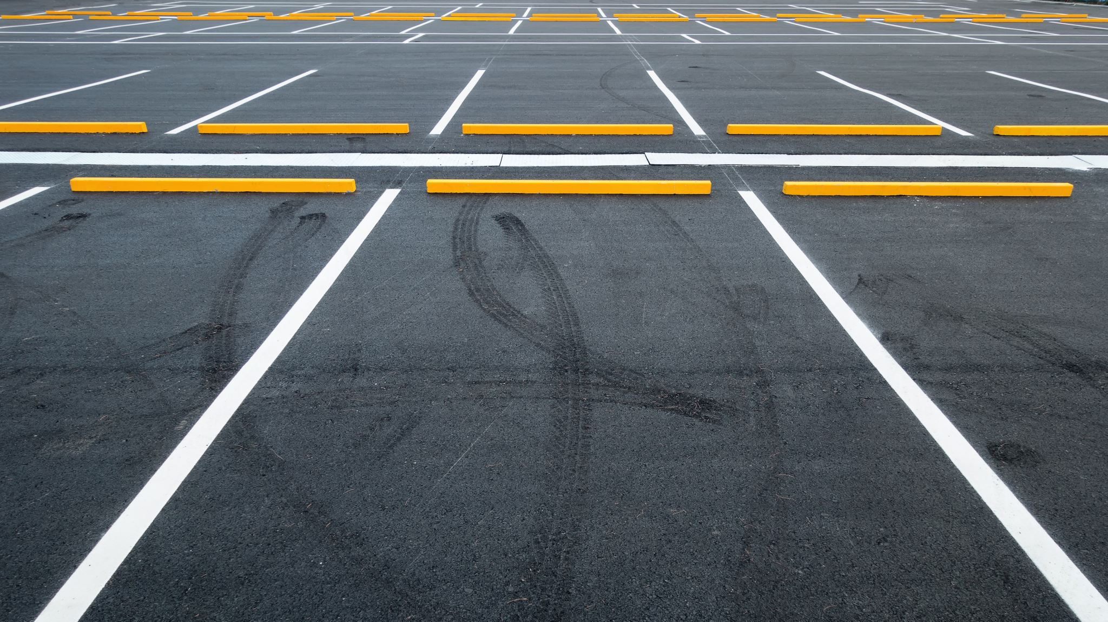
Smart Parking System(SPS)
By-
Hima-1602-20-737-136
Suman 1602-20-737-160
Hrudai-1602-20-737-162

Slide 2
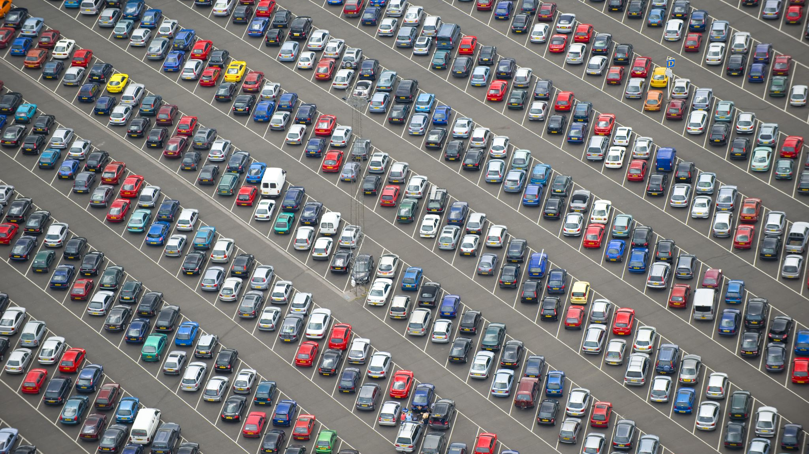
Problem Statement
Nowadays, an increase in population and as its direct result an increase in pollution is one of the major concerns of modern society. One such inevitable aspect of population explosion is that of increased vehicular traffic. As more and more people acquire vehicles, the need for available parking spaces increases drastically as well. Due to this, in urban areas, people end up burning a huge amount of unrenewable fossil fuels in search of parking spaces in designated parking lots (i.e. for malls, expos, carnivals, fairs, etc.)

Slide 3
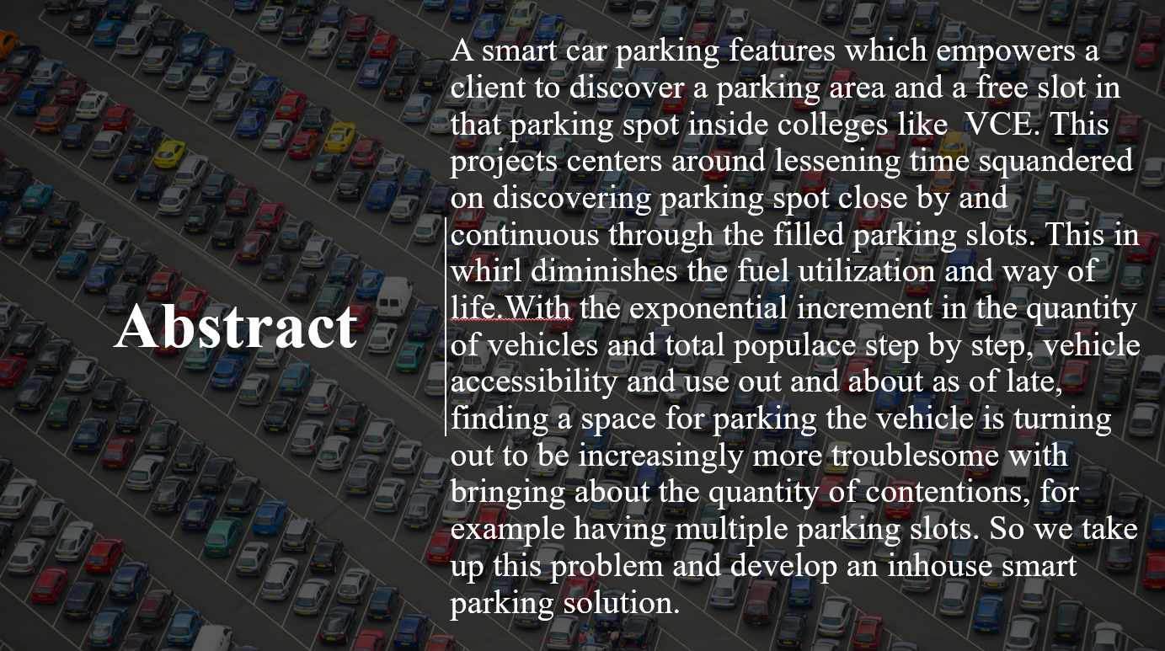

Slide 4
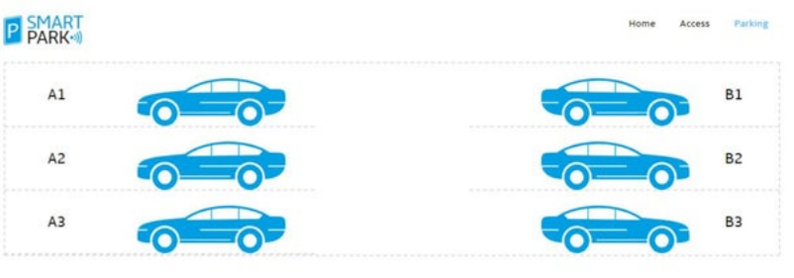
Project Motivation
Due to the exponential growth and development of IoT and cloud-based smart systems, the concept of developing smart cities has gained a new dimension. The goal of Smart City is to reduce operational costs, improve city management, enhance effectiveness, and improve productivity.

Slide 5
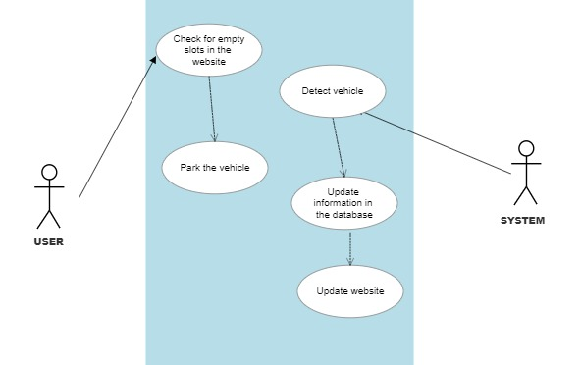
USE CASE DIAGRAM

Slide 6
Use Case Descriptions
CLIENT | SYSTEM
1.Choose the signup/register option
 | 2.Prompts for data required for registration
3.Enter the data prompted by the system
 | 4.Validate user information
Use Case 1
NAME: Register
Actors:User
Description: Allow new user to register for a profile
Pre-Condition: Car,Fasttag
Post-Condition: A profile is created for the user

Slide 7
Use Case Descriptions
CLIENT | SYSTEM
1.Enter the username, password and choose login option
 | 2.Validates username and password
Use Case 2
NAME: Login
Actors: User
Description: Allow registered user to login
Pre-Condition: User should be registered with the system
Post-Condition: User logs in and all the options are displayed on the screen

Slide 8
Use Case Descriptions
Use Case 3
NAME: Book Parking Slot
Actors: Client
Description: Allow user to book parking slots
Pre-Condition: User is logged in
Post-Condition: A parking slot is booked for the user and information updated in the database
CLIENT | SYSTEM
1.Clicks on book parking slot
 | 1.Books a parking slot

Slide 9
Use Case Descriptions
Use Case 4
NAME:Detect vehicle entry
Actors:System
Description: Detects entry of the vehicle
Pre-Condition: User has booked a slot and entry time is within expiry time
Post-Condition: None
CLIENT | SYSTEM
1.Entry with vehicle
 | 2.Detects and verifies slot booking

Slide 10
Use Case Descriptions
Use Case 5
NAME: Detect vehicle exit
Actors: System
Description: Detects exit of the vehicle
Pre-Condition: Vehicle is inside the parking slot
Post-Condition: A parking slot is emptied
CLIENT | SYSTEM
1.Exits with vehicle
 | 2.Detects and empties a parking slot

Slide 11
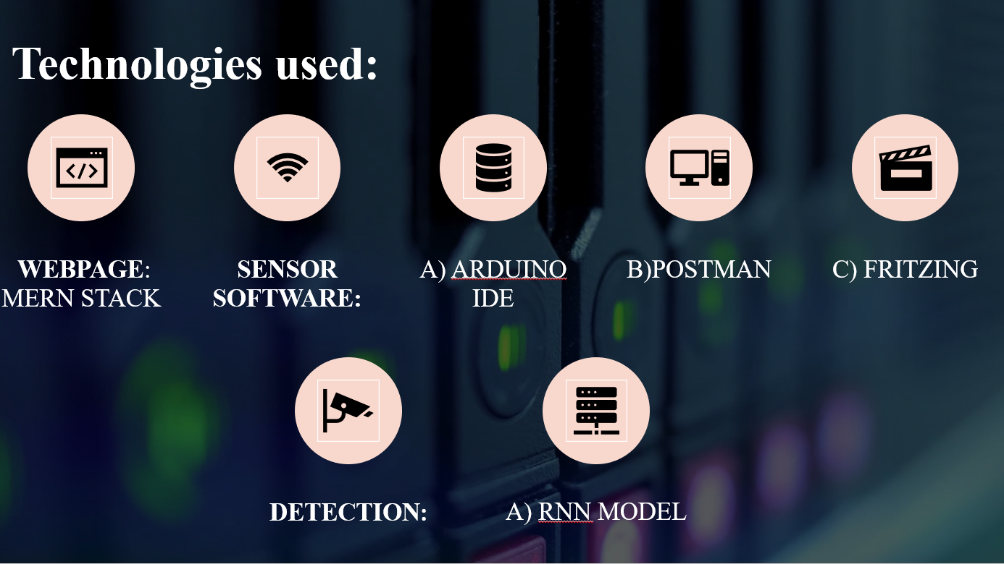


Slide 12
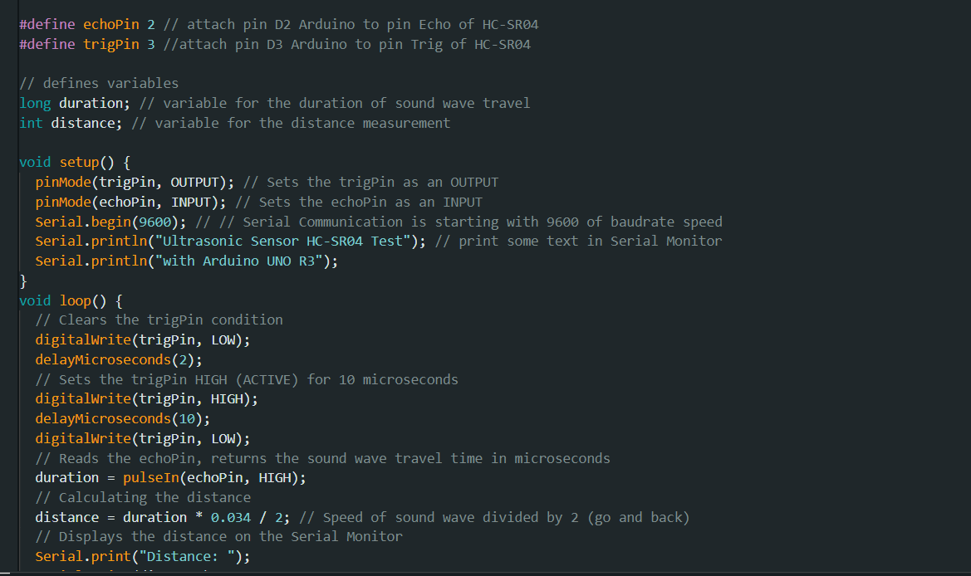
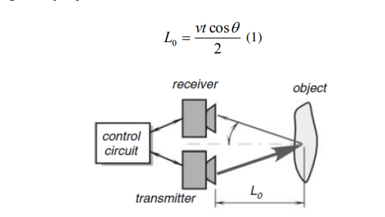
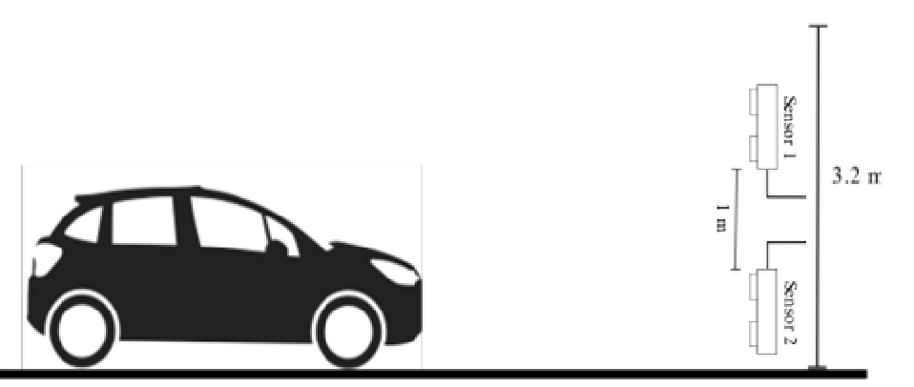
Principle
Ultrasonic sensors are suitable for target distance from 20 mm to 10 m : Roni Stiawan et al 2019 J. Phys.: Conf. Ser. 1204 012017

Slide 13
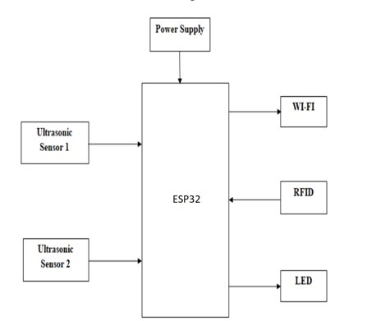
Block diagram of smart parking system (SPS) using ESP32

Slide 14
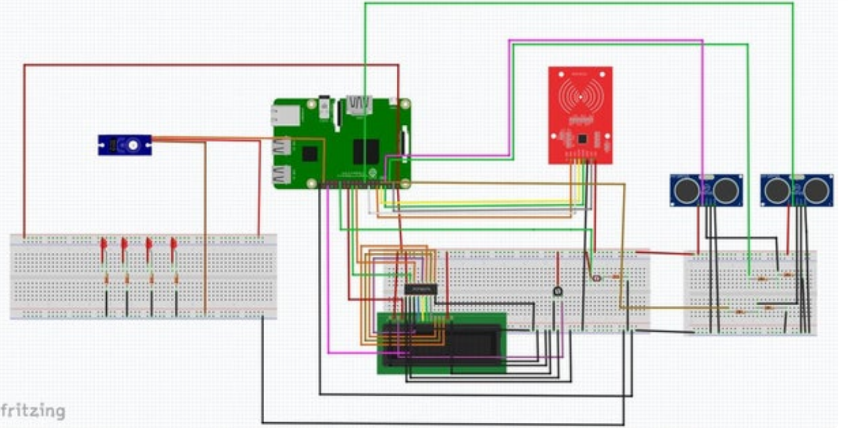
Circuit Diagram

Slide 15
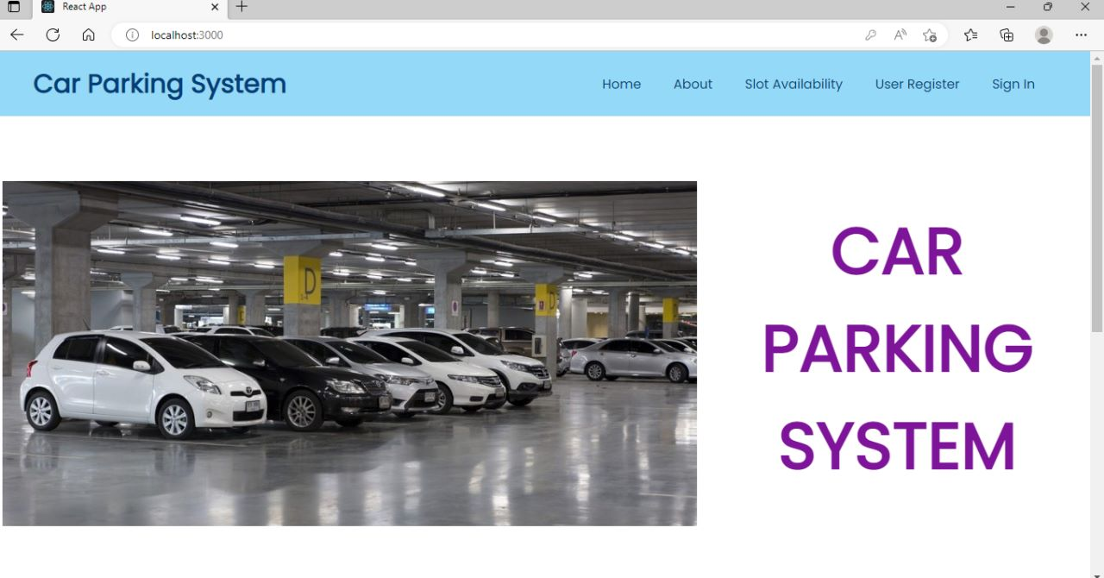
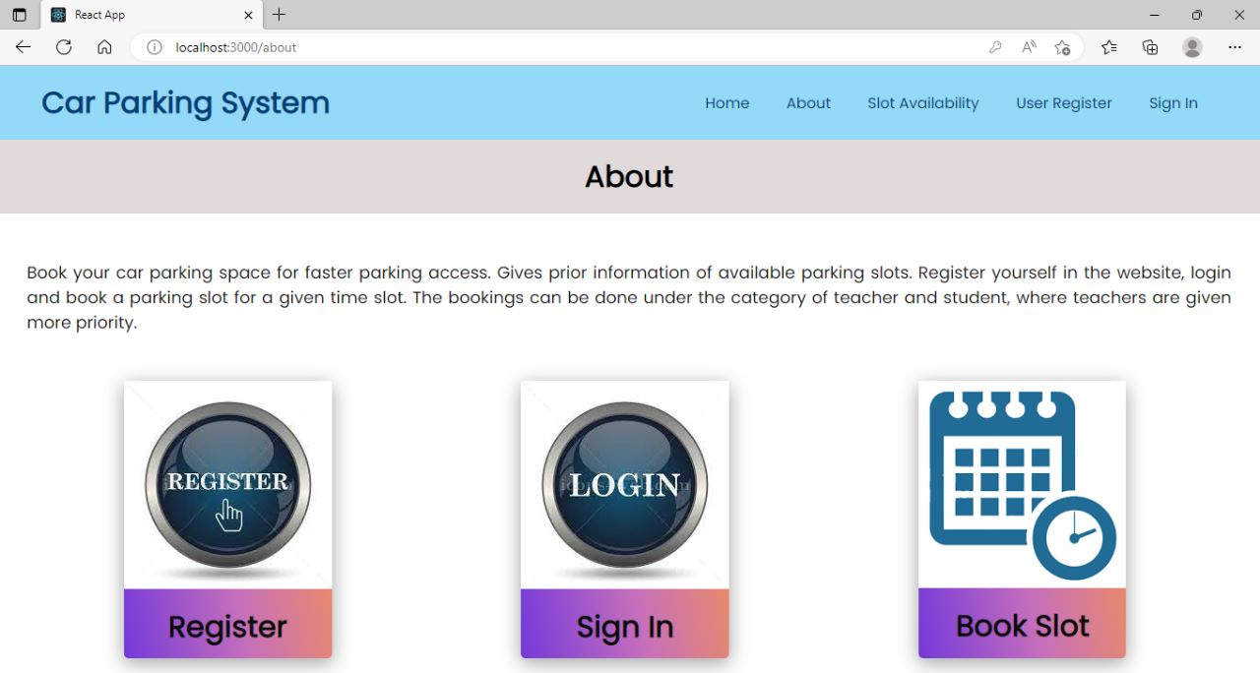
Web Interface

Slide 16
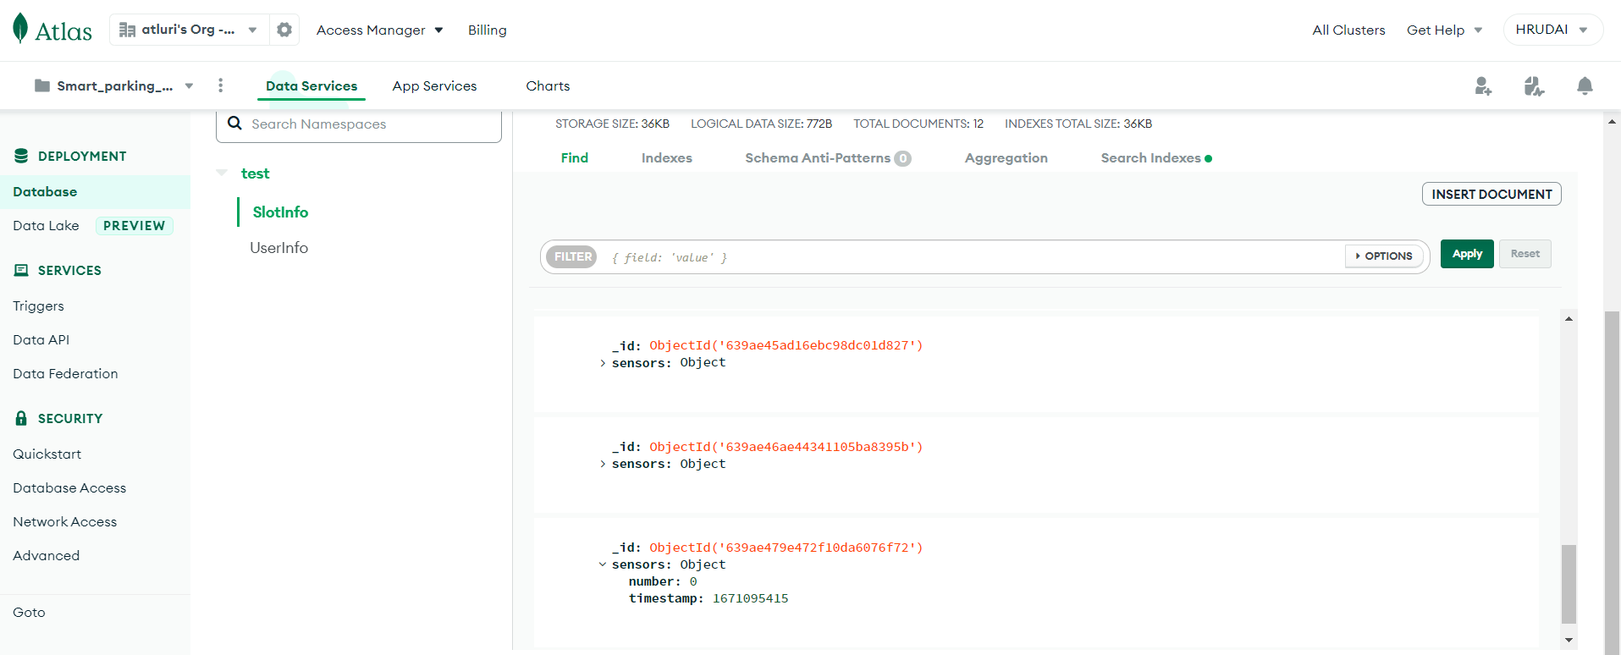
Database

Slide 17
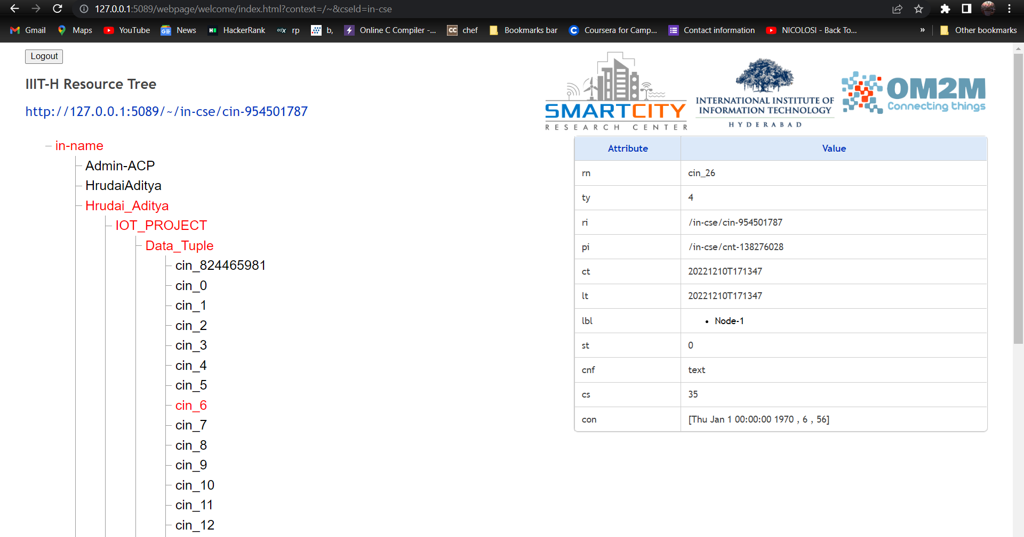
OM2M

Slide 18
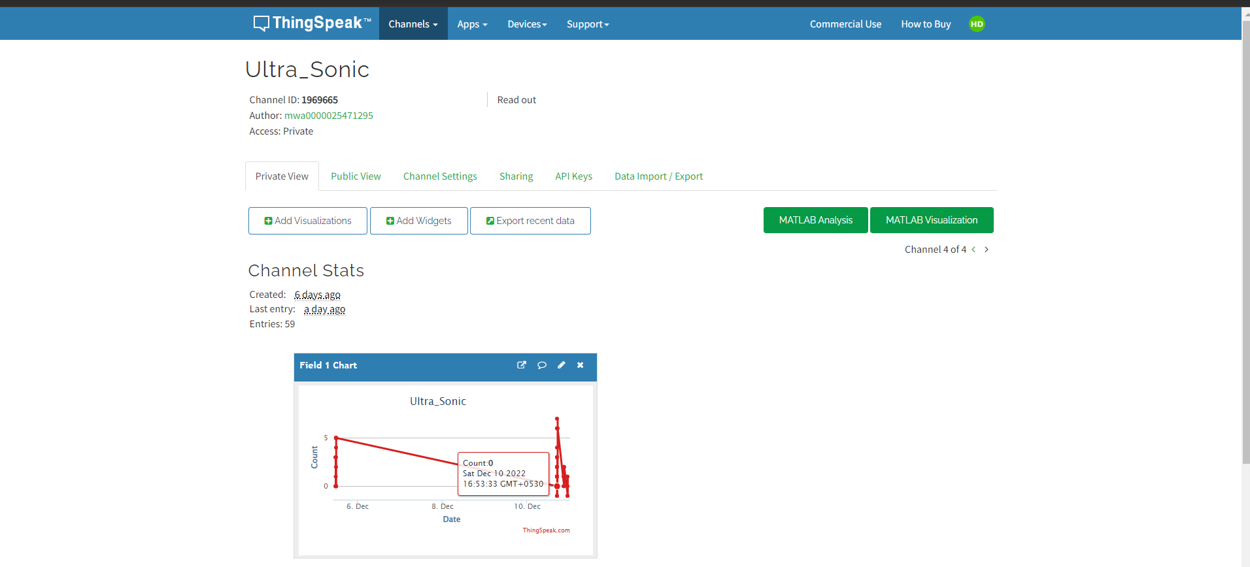
THINGSPEAK

Slide 19

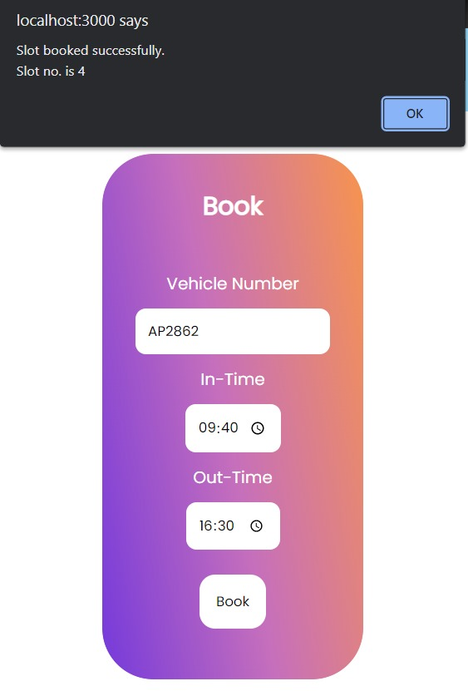
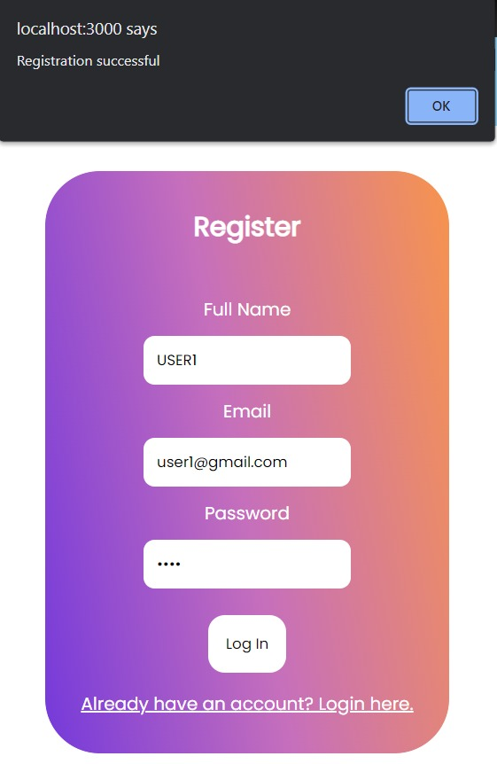
Results

Slide 20
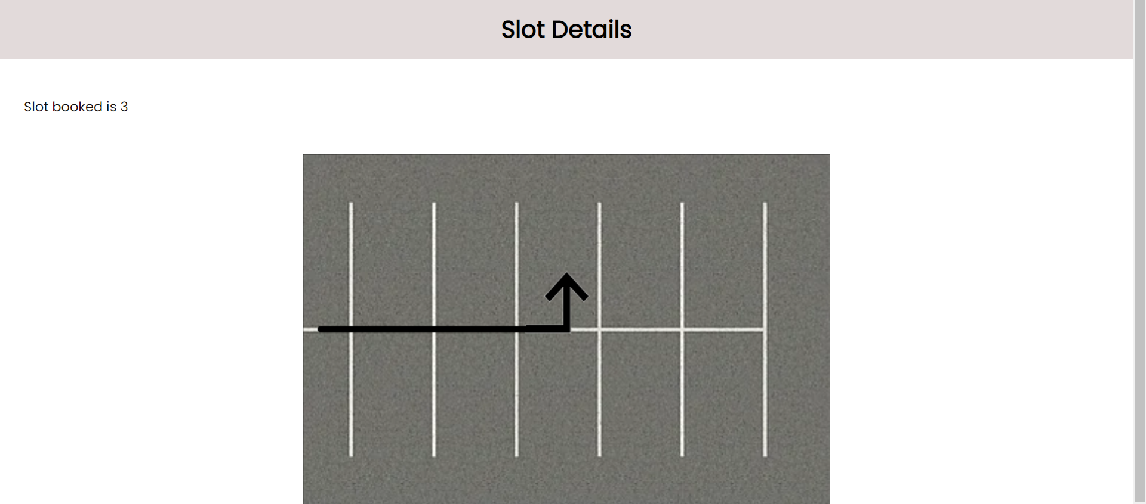
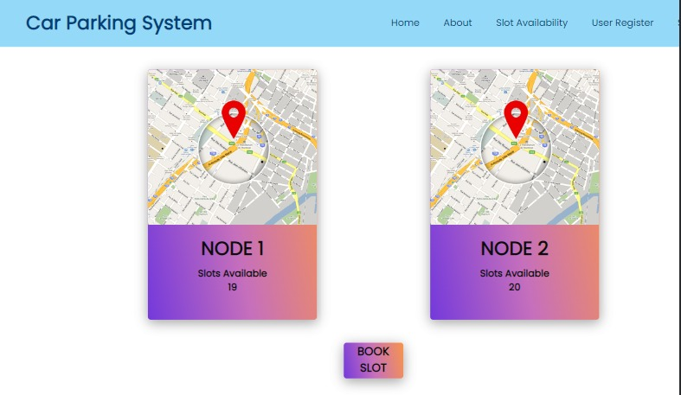

Slide 21
Future Work
The project can also be developed to detect 2-wheelers using ML/AI methodologies.
Dynamic API Connection with AndriodAuto
Slot booking based on priority
Showing routes using maps
The project can be further extended by developing an Android Application.

Slide 22

References
Smart parking system: Comprehensive revies based on various aspects-Heliyon-Abrar Fahim
Automated Systems using raspberry pi-IJRES

